Slide 1

Chapter 8
Structuring System Requirements:
Data Flow Diagram

Slide 2
Data-Flow Diagramming
◙ The dataflow diagram is a modeling tool that allows us to picture a system as a network of functional processes, connected to one another by flows and depositories of data.
◙ DFD is one of the most commonly used systems-modeling tools, particularly for operational systems in which the functions of the system are of most importance and more complex than the data that the system manipulates. If we are developing a system in which data relationships are more important than functions, we may de-emphasize DFDs.

Slide 3
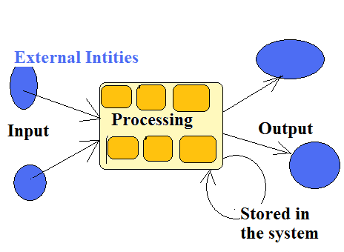
  DFD Used to Graphically Depict:
1. How data flow in a system?
2. Where data are transformed by a system?
3. Where data are stored (or sent) by a system?
# As a result, analysts keep track of data

Slide 4
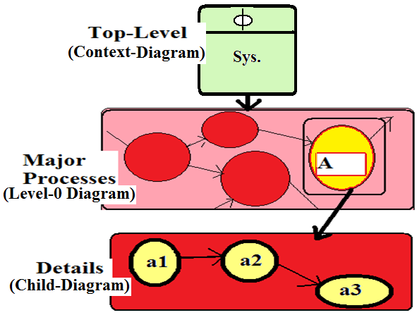
Levels of DFDs
# It can be drawn to represents different levels of details

Slide 5
Standard Symbols Used To Draw DFD
(i). Process/Transform/Bubble
  A process shows a part of the system that transforms inputs into outputs.
  A process is represented by a circle graphically, or a rectangle with rounded edges:
  A process name describes what the corresponding process does. {In some cases, a process will also contain the name of a person, a group of people, a computer, etc. They are used to describe who or what is carrying out the corresponding process.}
  The name can be a single word, phrase, or simple sentence.
A good name is consist of a verb-object phrase such as VALIDATE INPUT or COMPUTE TAX RATE.

Slide 6
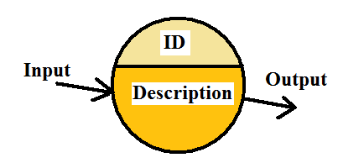
Process Symbol
Process
Description
Process ID
Data Flow In
Data Flow Out

Slide 7
(ii). Source / Sink (Also Known as External Entities or Terminators)
- Sources and Sinks are those entities that the system is communicating with.
Provider of Data \ Data out
Recipient of Data \ Data in
Source Name
Sink Name

Slide 8
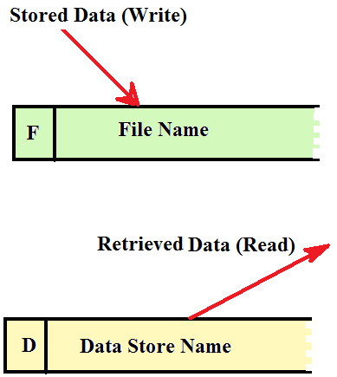
(iii) Data Store Symbol

Slide 9
Data Stores
Read (retrieved data)
  A store is used to model a collection of data packets at rest (files, tapes, punched cards, etc.). There are two ways of representing a store.
  The store may exist as a necessary time-delayed storage area between two processes that occur at different times.
  Stores are connected by flows to processes. There are two types of flows related to a store: a flow from a store, or a flow to a store.
A flow from a store is normally interpreted as a read or an access to information in the store.
A flow to a store is often described as a write, an update, or possibly a delete.

Slide 10
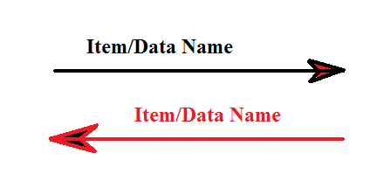
Arrows Symbol

Slide 11
(iv). Arrows Specify The Direction of Data Flow
A flow is represented graphically by an arrow into or out of a process.
  The flow is used to describe the movement of chunks, or packets of information from one part of the system to another part. It represents data in motion.
  Flows may be movement of data, or physical materials.
  The same chunk of data (e.g. Phone # 2609-8322) has a different meaning when it travels along the flow labeled PHONE-NUMBER than it does when it travels along the flow labeled VALID-PHONE-NUMBER.

Slide 12
Guidelines for Constructing DFDs:
Choose meaningful names
Number the processes
Avoid overly complex DFDs (maximum 9 bubbles)
Redraw the DFD as many times as necessary to enhance it.
Make sure that your DFD is logically consistent. To ensure consistency:
  Avoid infinite sinks, bubbles that have inputs but no outputs
  Avoid spontaneous generation bubbles, bubbles that have outputs but no inputs are suspicious and generally incorrect
  Beware of unlabelled flows and unlabelled processes

Slide 13
Leveled DFDs
(i). Context-Diagram (System Vs Environment)
- It frames the essence (fundamental) of a system.
  - It represents the Top-Level diagram in a set of DFDs.
  -The top level DFD consists of only one bubble, representing the entire system; the dataflows show the interfaces between the system and the external entities.
  The analyst should identify
      All data flows INTO & OUT of the system.
      All Sources and Sinks.
Provider of Data Receiver of Data

Slide 14
Remarks on Context Diagram
No (or zero) ID for the Process
Only one process
Name is usually a NOUN (system name)
No Data Stores

Slide 15
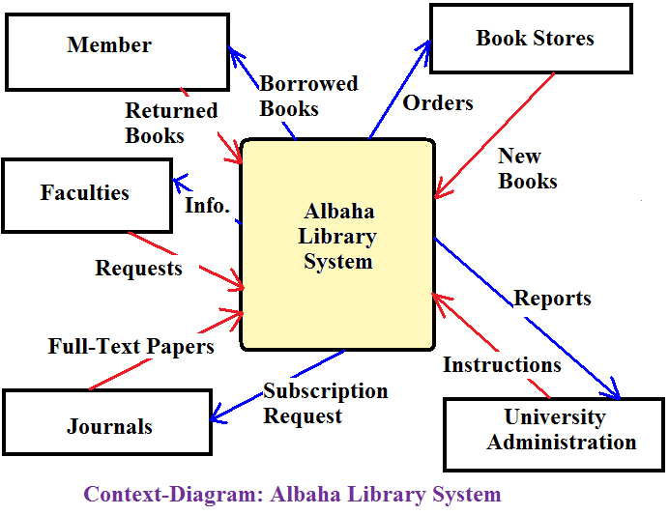
Example-1: Context Diagram Albaha Library Systemنظام المكتبة
Ø

Slide 16
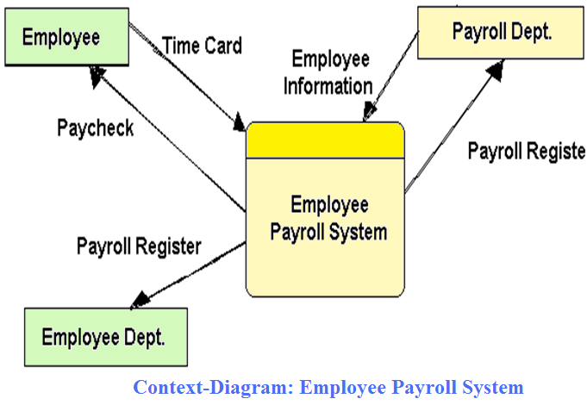
Example-2: Context Diagram Payroll
System مثال نظام الرواتب
Ø

Slide 17
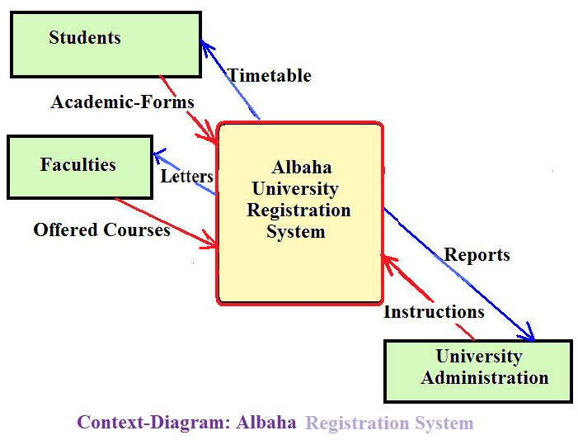
Example-3: Context Diagram Registration System
مثال نظام التسجيل
Ø

Slide 18
ii). Level-0 DFD (next level down)
It represents the view of the major functions within the system, as well as the major interfaces between those functions
  Once The Context-Diagram is Done, A Level-0 DFD can be prepared.
  The Analyst begins to Identify Main Functions (One Per Bubble) and see how those functions linked together.
  Remark:
- Numbering Methods:
  o First Major Process Takes 1.
  o Second Major Process Takes 2.
  : : : :
  o 9th Major Process Takes 9.
  Maximum no. of processes on one diagram is 9 (for the sake of simplicity)
0
0
0
0

Slide 19
Process-Description
Must be an ACTION-VERB.
All Source & Sinks Appeared on The Context–Diagram must also appear on The Level-0 DFD.
All Major Inputs & Outputs Appeared on The Context–Diagram must also appear on The Level-0 DFD (they must match in Numbers & descriptions/names)
Data Storage, usually, appear on Level-0 for the first time.

Slide 20
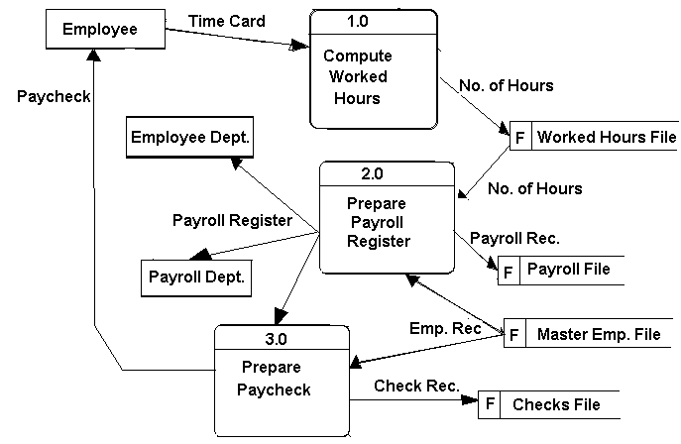
Example : Draw Level-0 DFD for the Payroll System

Slide 21
(iii). Child Diagram (More Detailed Level)
Any Complex-Process on Level-0 can be exploded into a new Detailed Child-Diagram. { The Level-0 Process will be called the Parent-Process}
Remark:
- A Child Diagram cannot produce Output or receive Input that the Parent–Process doesn't have.
- All Data Flow In or Out of the Parent–Process must be also shown on the Corresponding Child-Diagram .
- Numbering of the process on the Child Diagram as follows:
    First Process ParentID.1
    Second Process ParentID.2
    Third Process ParentID.3
    : :
    9th Process ParentID.9
Entities (Sources & Sinks), usually not shown on the Child–Diagram.
Data Stores appear accordingly (those associated with the parent-process).
Additional Data Stores (e.g. Lookup-Tables) and additional minor data flows (eg. Error-Lines) may appear on the Child-Diagram for the first time (it didn't appear on the Parent–Process.)

Slide 22
First set of Child-Diagrams may not necessarily represent the final or lowest-level of details, some of the processes on the Child-Diagram can further be exploded into a NEW Child-Diagram providing more
detailed level of information. And the same rule apply for the parent-process.
For example the explosion of the first process on the Child-Diagram, the Numbering of the resulting Child-Diagram will be as follows:
  o First Process ParentID.1.1
  o Second Process ParentID.1.2
  o Third Process ParentID.1.3
  o : :
  o 9th Process ParentID.1.9
As long a process can be exploded it is know as a COMPLEX-Process otherwise the most simplified process is called a PRIMITIVE-Process

Slide 23
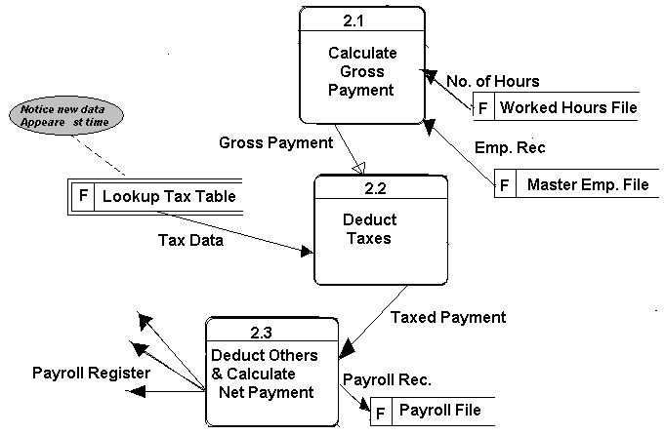
Example: Draw Child-Diagram for Process No. 2 on Level-0 DFD for the Payroll System
(Process # 2.0 is the Parent Process for This Child-Diagram)
Remarks:
A Source/Sink should have a Noun–Phrase.
A Data Flow To a Data-Store is a result of Update/Change or Write/Store operation.
A Data Flow From a Data-Store is a result of Retrieve/Read Operation
A Data Flow MUST be labeled with a Noun-Phrase.
A Process-Name MUST be an Action-Verb.

Slide 24
Rules for Drawing DFDs :
A.
B.
C.
Rule
Incorrect
Correct
#
A
B
K
#
Dsrp
Dsrp
A
B
A
Dsrp
A
#
#
Dsrp
B
Invoic
No.
2.0
Invoic
No.
Invoice
2.0
Prepare
Invoice
Rec
Total
AMT
Total
AMT

Slide 25
D.
E.
Transaction
F
Transaction
F
Cus.Rec
#
Cus.Rec
F
Dsrp
Master File
Cus.Rec
Master File
F
A
Source
File-Name
F
dsrp
A
#
F| File-Name
A
source

Slide 26
G.
H.
I.
Source
Sink
Source
#
Bank
Customer
Prepare
Bank State
Sink
Bank
Customer
B
#
DSRP
A
#
DSRP
A
A
F | File Name
F | File Name
C
D
#
D
A
Dsrp
C
#
A
Dsrp
Dsrp
#
Dsrp
B
#
D
Dsrp
D
B
Dsrp

Slide 27
D
B
D
B
#
#
Dsrp
J.
K.
A
Dsrp
A
#
#
Dsrp
Dsrp
D
#
D
B
B
Dsrp
#
Dsrp
#
D
A
Dsrp
B
#
Dsrp
Dsrp
#
A
A
#
A
Dsrp

Slide 28
Balancing DFDs
When decomposing a DFD, you must conserve inputs to and outputs from a process at the next level of decomposition
  This is called balancing
6.<number>

Slide 29
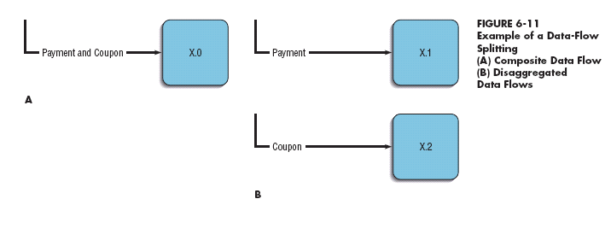
Balancing DFDs
We can split a data flow into separate data flows on a lower level diagram
6.<number>

Slide 30
Guidelines for Drawing DFDs
Completeness
  DFD must include all components necessary for the system
  Each component must be fully described in the project dictionary or CASE repository
Consistency
  The extent to which information contained on one level of a set of nested DFDs is also included on other levels
6.<number>

Slide 31
Guidelines for Drawing DFDs (continued)
Timing
  Time is not represented well on DFDs
  Best to draw DFDs as if the system has never started and will never stop
Iterative Development
  Analyst should expect to redraw diagram several times before reaching the closest approximation to the system being modeled
6.<number>

Slide 32
Guidelines for Drawing DFDs (continued)
Primitive DFDs
  Lowest logical level of decomposition
  Decision has to be made when to stop decomposition
6.<number>

Slide 33
Guidelines for Drawing DFDs (continued)
Rules for stopping decomposition:
  When each process has been reduced to a single decision, calculation or database operation
  When each data store represents data about a single entity
  When the system user does not care to see any more detail
6.<number>

Slide 34
THE END

